Slide 1
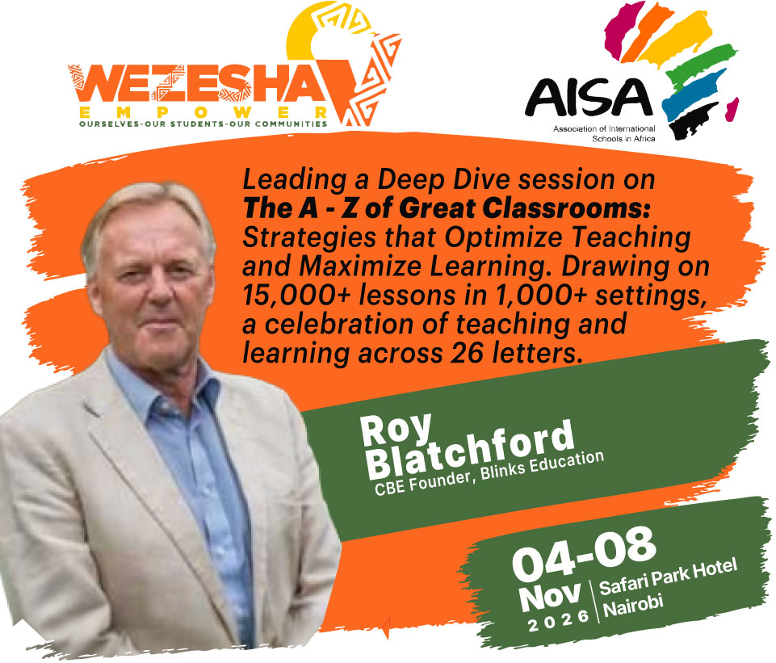

Slide 2
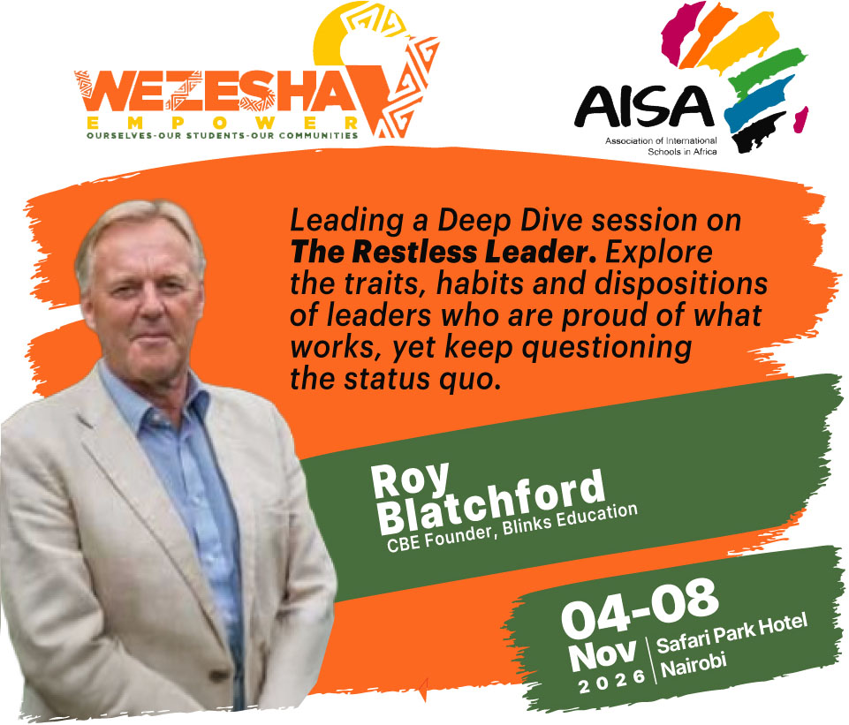

Slide 3
Date | Session & title | Registrants | Time | Notes
Fri 6 Nov | Deep Dive 1: The A - Z of Great Classrooms: Strategies that Optimize Teaching and Maximize Learning | 12 | 11:00 – 13:00 & 15:00 - 17:00 | 4 hours of facilitation with a 2-hour lunch break
Sat 7 Nov | Deep Dive 2: The Restless Leader | 22 | 11:00 – 13:00 & 15:00 - 17:00 | 4 hours of facilitation with a 2-hour lunch break

Slide 4
Excellence is not an act but a habit (Aristotle)
High intention in practice means that leaders and teams at all levels set out high, specific ambitions in their respective domains.
Sincere effort means that all staff approach their daily and weekly tasks with a sincerity and commitment that is personally and professionally satisfying.
Intelligent execution means that all staff think intelligently and practically about the best ways to achieve their goals.
(‘The Restless School’)

Slide 5
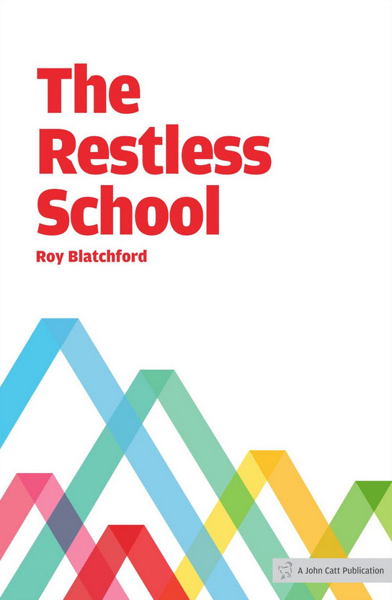

Slide 6


Slide 7


Slide 8
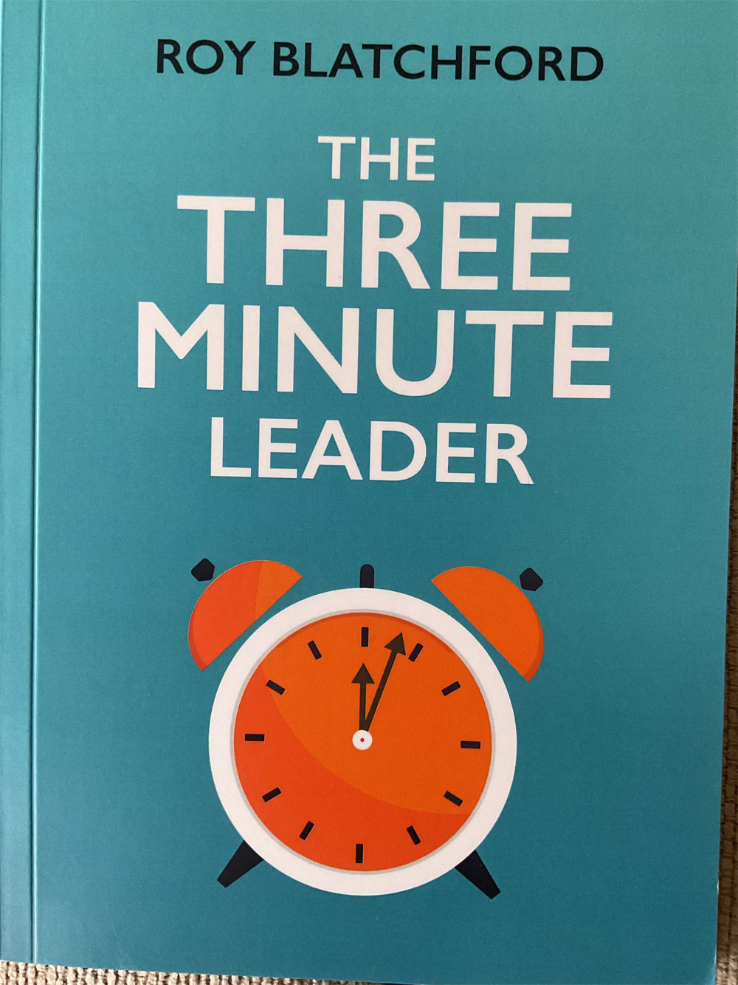

Slide 9


Slide 10


Slide 11
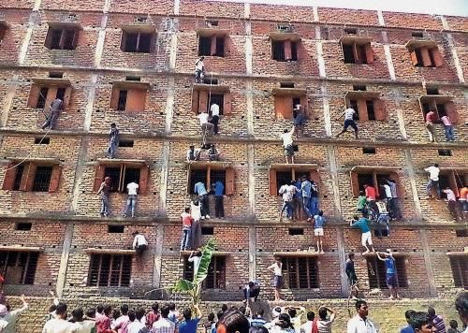

Slide 12


Slide 13
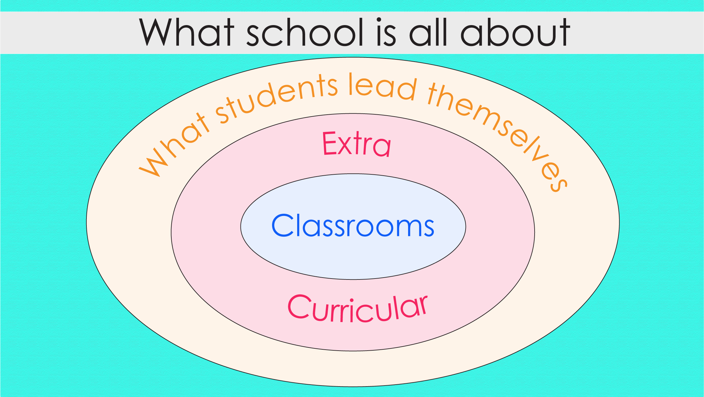

Slide 14
The A-Z of every classroom
Reading
Cultural
capital
Oracy
Vocabulary

Slide 15
The Children Act - Ian McEwan
‘She listed some relevant ingredients, goals towards which a child might grow.
Economic and moral freedom, virtue, compassion and altruism, satisfying work through enagagement with demanding tasks, a flourishing network of personal relationships, earning the esteem of others, pursiung larger meaninigs to one’s existence. and having at the centre of one’s life one or a small number of significant relations defined above all by love.’

Slide 16
Cultural capital
Call ‘cultural capital’ General Knowledge.
Keep a large, spinning globe on your desk.
Assumicide: don’t assume that children know or do not know something.
Climb inside another’s skin.
Teacher, feed your own soul and intellect

Slide 17
All societies in education wrestle with....
Knowledge and Skills (which shall be first among equals?)
3Rs - 4Rs?
Technologies - help or hindrance?
National identity
Citizen for today and tomorrow

Slide 18
21st Century Zeitgeist
Climate degradation (Tim Marshall)
The movement of peoples (Paul Collier)
Religious wars (Richard Dawkins)
Liberal democracies don’t have (all) the answers..... (Fukuyama)
What’s it like to be someone else? Climb inside their skin....

Slide 19
X features of great classrooms
1. The teacher has knowledge effortlessly rising out of them like sap from a tree – and keeps perfecting their craft. Students are inspired.
2. The teacher commands the classroom, physically and intellectually, and students respond positively to that expertly planned climate for learning.
3. The passion for excellence and scholarship, rooted in the teacher’s own achievements, is palpable and often thrilling. Children want to practise, rehearse and emulate top achievements.
4. A teacher’s unambiguous set of values, embodying integrity and clear conscience, underpin memorable classroom practices. Children feel secure.
5. The fun in learning is teachers and students sharing humour and wit, rooted in risk-taking, digression and applying learning beyond the classroom.

Slide 20
X features of great classrooms
6. The creative teacher has a predictable unpredictability about their person. Students know they are in for some memorable learning.
7. What teachers expect is what they get in any classroom, in any subject, and in any context. Children are no fools; they willingly respond to high expectations.
8. Empathy is that vital capacity in a teacher to imagine and understand that the learner may well have a different frame of reference. Students highly respect this.
9. Resilience is two-track: one for the pupils’ stamina in new learning; and one for the teacher’s self-preservation and ultimate flourishing. Both live to teach and learn another day.
10. Reflecting on what they are achieving in classrooms becomes the teacher’s and the students’ habit. Together, they practise being excellent. RB.

Slide 21
Questions asked by students
Am I happy and motivated in class, collaborating with my friends to make progress?
Am I using my time well in class?
Is the teacher aiding and extending me, given my starting points?
Does the teacher deepen my learning from time to time?

Slide 22
Great learning
Where a range of students’ needs are fully met: teachers leave the textbook behind; take happy risks; ask searching questions; embrace digression; set rich tasks - all rooted in their own great subject knowledge. BUZZY……
Students say their learning is deepened when teachers help them to make intriguing, explicit links between different curriculum subjects; and when 10% of the learning is ‘out of the window’, embedding understanding of new skills and knowledge through application to everyday life. MESSY…..

Slide 23


Slide 24
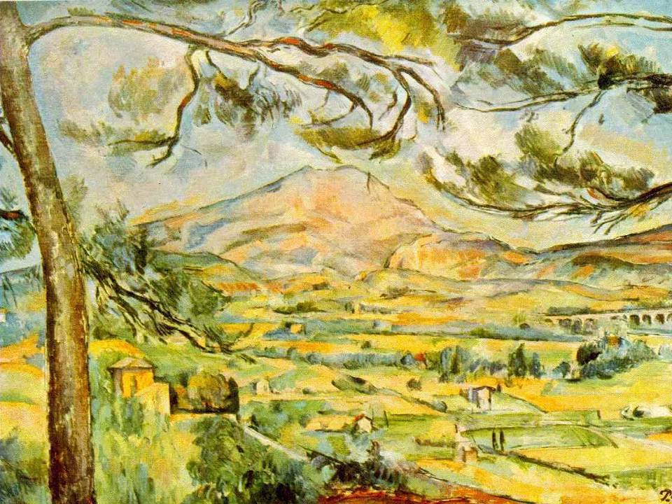

Slide 25
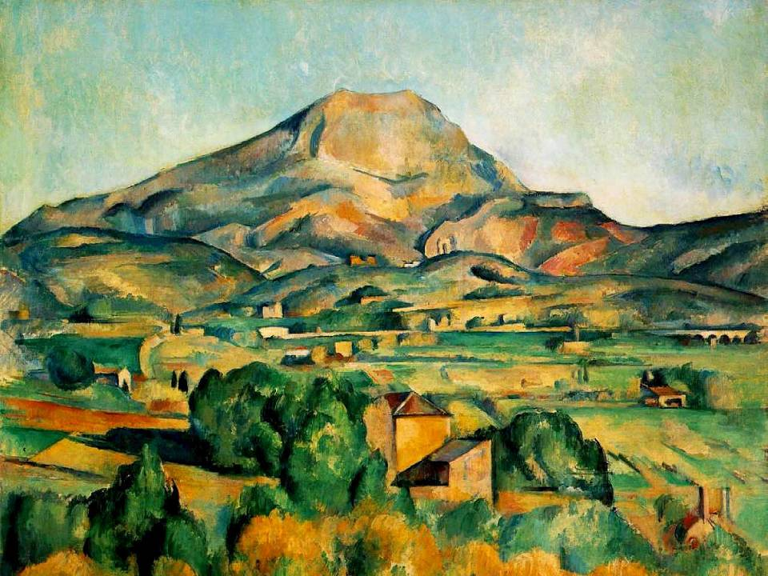

Slide 26
What do great schools do? One….
7 platforms
Expectations
Behaviours
Environments
Teachers
Supporters
Leaders
Critics (‘The Restless School’)

Slide 27
What do great schools do? Two….
6 pillars
High expectations
Excellent teaching
Knowing every child
Depth for breadth
Exemplary behaviours
Always learning (Ark)

Slide 28
What do great schools do? Three
7 pillars
Mindset shift
Enquiry-based learning
Expertise development
Practice and training
Feedback
Engagement of parents
With students, not to them (High Performance Learning)

Slide 29
Excellence is not an act but a habit (Aristotle)
High intention in practice means that leaders and teams at all levels set out high, specific ambitions in their respective domains.
Sincere effort means that all staff approach their daily and weekly tasks with a sincerity and commitment that is personally and professionally satisfying.
Intelligent execution means that all staff think intelligently and practically about the best ways to achieve their goals.
(‘The Restless School’)

Slide 30
What do we conclude?!
Thomas More: Why not be a teacher? You’d be a fine teacher,
perhaps a great one.
Richard Rich: If I was, who would know it?
Thomas More: You, your pupils, your friends, God. Not a bad
public, that.
‘A Man for All Seasons’ by Robert Bolt

